Slide 1
Culture
Dr J Balamurugan

Slide 2
Meaning of Culture
Culture is a very broad that includes in itself all our way of life,
modes of behaviour,
our philosophies and ethics,
our morals and manners,
our customs and traditions,
our religious, political, economic and other type of activities.

Slide 3
Meaning of Culture
It is main concept in Anthropology but it is essential or fundamental in Sociology.
The study of society becomes incomplete without a proper understanding of the culture of the society.
Culture and society go together they are inseparable.
Culture refers to a system of learned behaviour which is shared by and transmitted among the members of a group.

Slide 4
Definition of culture
Tylor – Culture is that complex whole which includes knowledge, belief, art, morals, law, custom and any other capabilities acquired by man, as a member of society.
Roberty – Culture is the body of thought and knowledge, both theoretical and practical, which only man can possess.

Slide 5
Nature of culture
Culture is a acquired quality.
Culture is social, not individual heritage of man.
Culture is idealistic.
Culture fulfils some needs.
Culture is an integrated system.
Language is the chief vehicle of culture.
culture is varies from society to society.

Slide 6
Nature of culture
Culture is an acquired quality:
Culture is not innate. Culture is learned.
Traits learned through socialization, habits and thoughts are what is called culture.
Culture is social, not individual heritage of man:
It is a social product which is shared by most members of the group.

Slide 7
Nature of culture
Culture is idealistic:
Culture embodies the ideas and norms of a group.
It is the expression of human mind in the course of history.
Culture is the total social heritage:
It is passed from one generation to another through traditions and customs.

Slide 8
Nature of culture
Culture fulfils some needs:
It fulfils those ethical and social needs of the group.
Culture is an integrated system:
Its various parts are integrated with each other.
New element which is introduced is also integrated.

Slide 9
Nature of culture
Language is the chief vehicle of culture:
Man lives not only in the present but also in the past and future.
Through language culture transmits to past to present and present to future.
Culture is varies from society to society:
Every society has a culture of its own, it not uniform.
Culture is different from US to India.

Slide 10
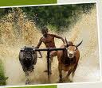
Structure of Culture
Cultural traits
The single element or smallest unit of culture.
Cultural complex
Cultural complex nothing but larger cluster of traits.
Cultural pattern
Culture pattern formed when traits and complexes become related to each other in functional roles.

Slide 11

Functions of Culture
For individual
Culture makes man become a human being
Culture provides solutions for complicated situations
Culture provides traditional interpretations to certain situations.
For the group
Culture keeps social relationships intact
Culture broadens the vision of the individual
Culture creates new needs

Slide 12
Evolution of Culture
For a century and more Archaeologists have dug up the tools, weapons, pottery, idols, coins and other material things of people who have long since died out.
It is the clues to their social life.
The Archaeologists do not reveal the origin of culture, they only indicate its olden days.
If they reveal something about the evolution of culture, it is only about its material aspects.

Slide 13
Evolution of Culture
To trace the origin of a specific cultural trait is difficult.
All cultural traits – material as well as non-material – have been invented at some time and in some place by some person.
No single invention contributes very much to the development of a culture, it is only an addition to what already exists.
Culture is only partly new.
Ex: The music composer of a new song take bits from number of pervious compositions.

Slide 14
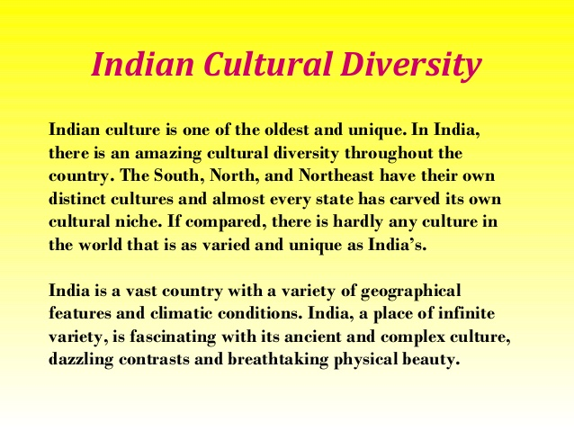

Slide 15

Diversity of Culture
Because of
Historical Accidents
Geographical Environment
Mobility of human organism
Inventions and Discoveries
Individual peculiarities
Change in modes of production
Dominant cultural themes

Slide 16
Diversity of culture
Diversity:
Its based on the religion
Language
Way of life
Tradition
Locality
Geographical area
Family environment

Slide 17
Thank you

